Slide 1


STUDENTS
Gist
'Worry less, Buy more'
Made with by -
KARTIK TYAGI
PRAGYA SRIVASTAVA
SHALINI KUMARI RAI
GitHub link:-
https://github.com/Students-Gist/studentsgist.github.io

Slide 2



Work Flow :-
Pragya Srivastava: Header Page Sign Up/In Modal Wish List Disclaimer Presentation Work
Shalini Kumari Rai: Footer Contact Form Assembly of index page About Us Privacy Policy
Kartik Tyagi: Index Ad preview Template Ad Upload Page Backend

Slide 3






Technologies Used

Slide 4

What is Student Gist?
Students Gist is a platform for buying and selling services and goods such as electronics, books, fashion items, Laptops and Mobiles.
So, what’s different in it?
- Student Gist is an online marketplace for college/University/Institute/School.
` - Easy to Use, vibrant in features, and Likeable interface for Students specific.
- It has special features.
What special feature?
- Make a wish list of your own choice of goods.
- “We respect your Privacy”. Control your details
which are to be shown.
- ‘Preview’ before ‘Post’.
- Sell Services/Coupons/Vouchers etc.

Slide 5

Why this Students Gist?
To provide users to purchase items like books online.
To provide user to sell old products.
It is Students oriented marketplace.
To reduce user's searching time.
To provide great discount over purchasing.
To provide wide collection of item ranges.
To provide user friendly environment.
To provide facility of user feedback.
To provide acknowledge to the user.

Slide 6

FUNCTIONAL REQUIREMENTS
Browser Items/Ads:-
An user logging into the site can browse through the items both by category or in a random manner.
View Details:-
An user can also view the details of the item like book(eg.: price, author etc ).
Add to Wish list :-
The user can add the items of his choice to the shopping cart.
Make Offers:-
The user ultimately visits his cart and make an Offer to the Seller.

Slide 7
Ad Id
Title
Description
Images
PREVIEW
Unique Id
Rows Count
Remaining data
Database
Link: href="product-detail.php?clicked=<?php echo $row['adid'];?>
While Loop: Rows Count
Preview Templates
Sign Up/In modules
Ad-Upload Page
Unique Id
Ad-Detail Page
Unique Id = User Id + Ad Id
Link
Working Flow Chart
HomePage

Slide 8
Ad Id
Title
Description
Images
PREVIEW
Unique Id
Rows Count
Remaining data
Database
Link: href="product-detail.php?clicked=<?php echo $row['adid'];?>
While Loop: Rows Count
Preview Templates
Sign Up/In modules
Ad-Upload Page
Unique Id
Ad-Detail Page
Unique Id = User Id + Ad Id
Link
Working Flow Chart
HomePage

Slide 9
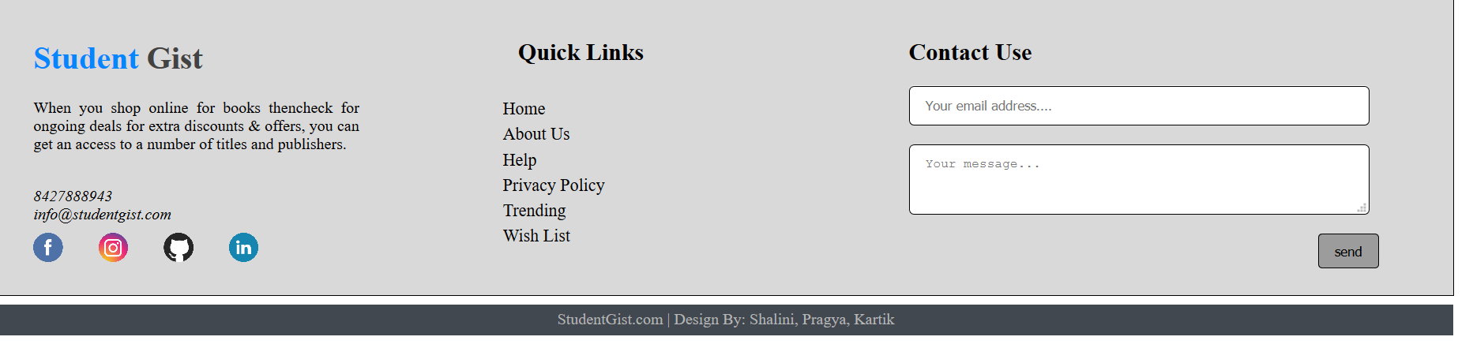
SCREENSHOTS OF THE WEBSITE
Header:-
FOOTER:-

Slide 10
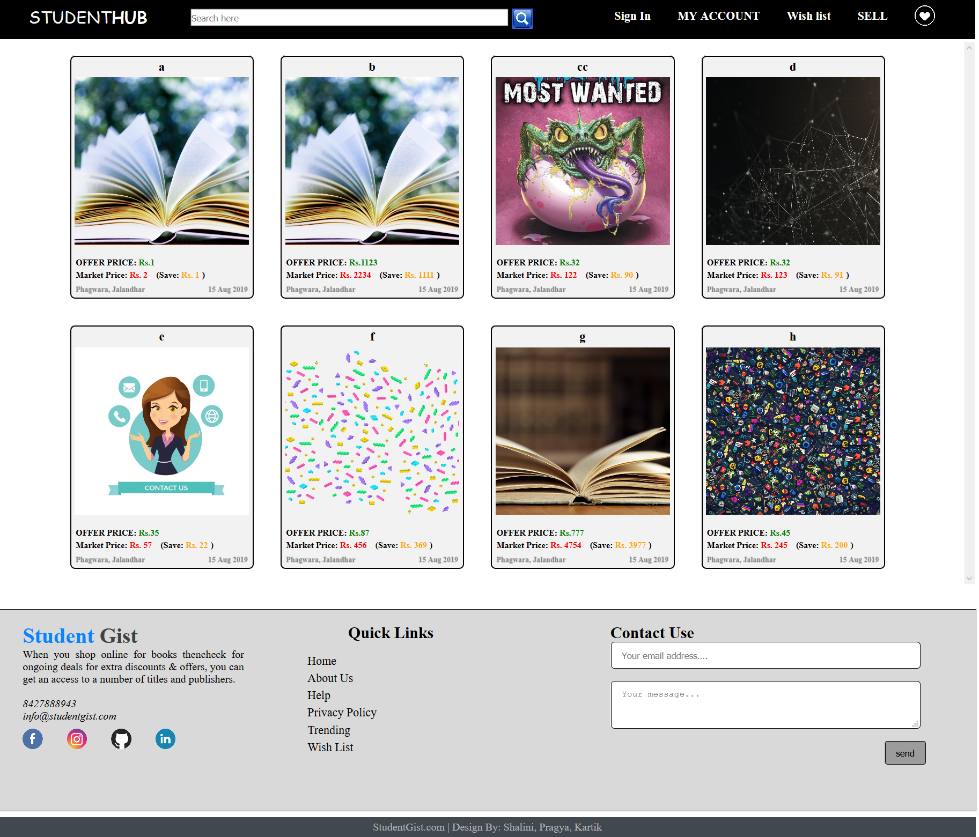
INDEX PAGE:-

Slide 11
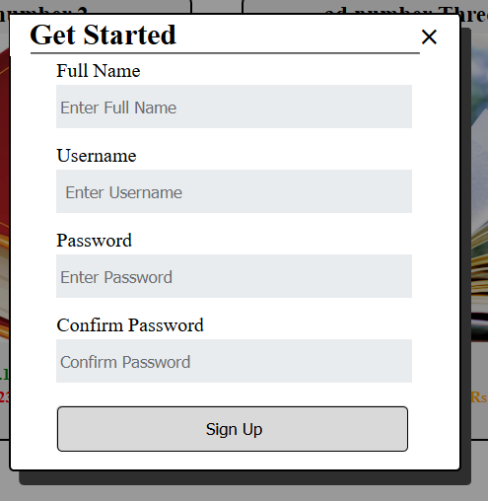
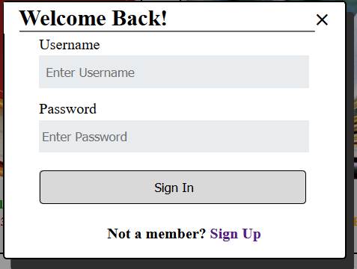
Sign Up
Sign In

Slide 12
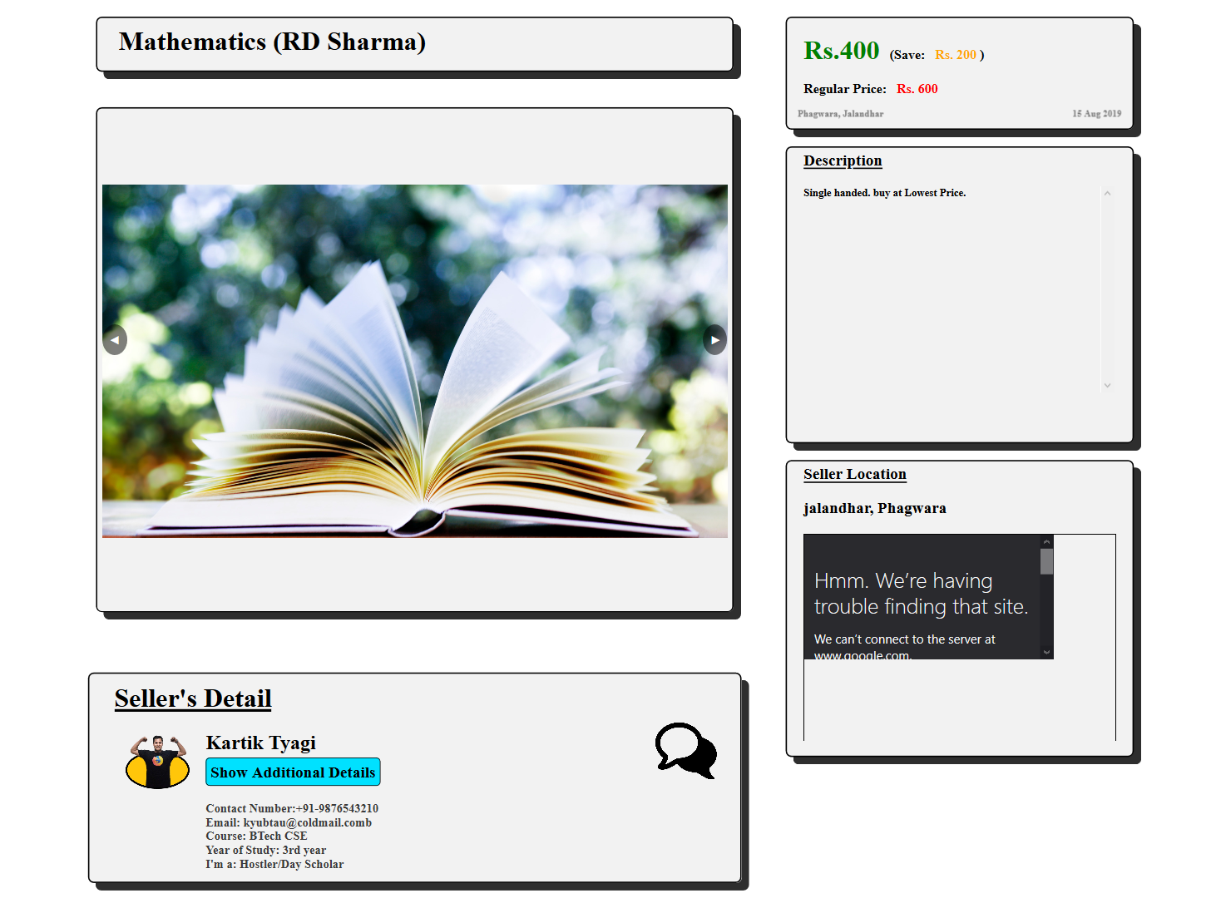
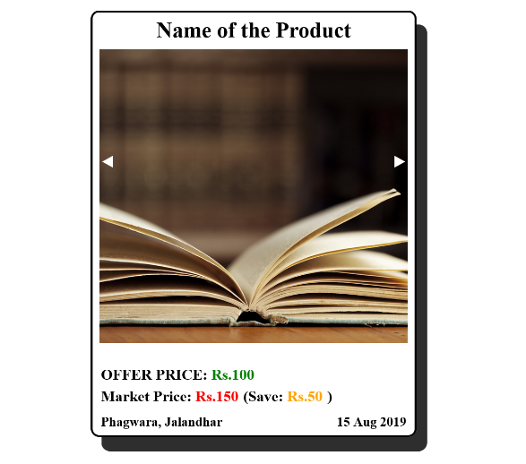
PRODUCT DETAILS:-
PREVIEW TEMPLATE:-

Slide 13
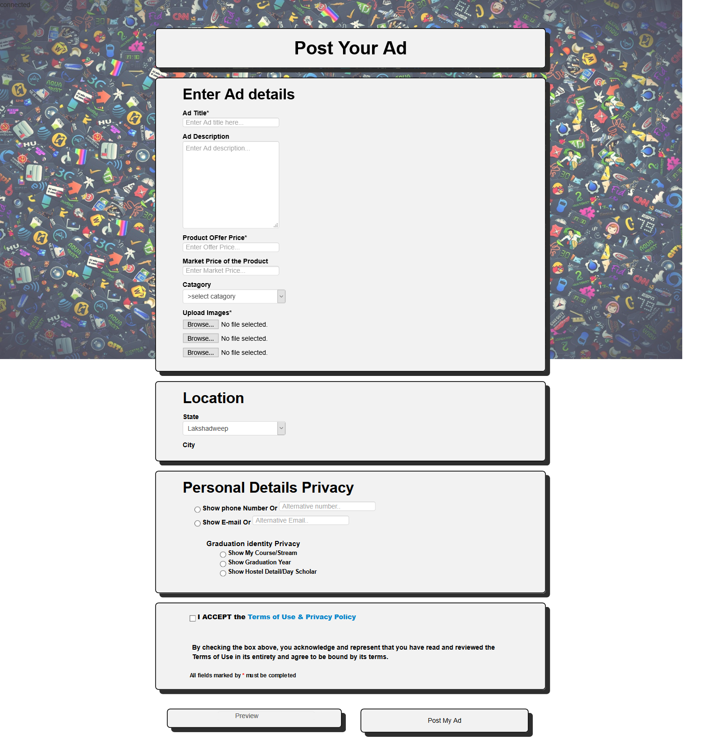
AD-UPLOAD PAGE:-

Slide 14
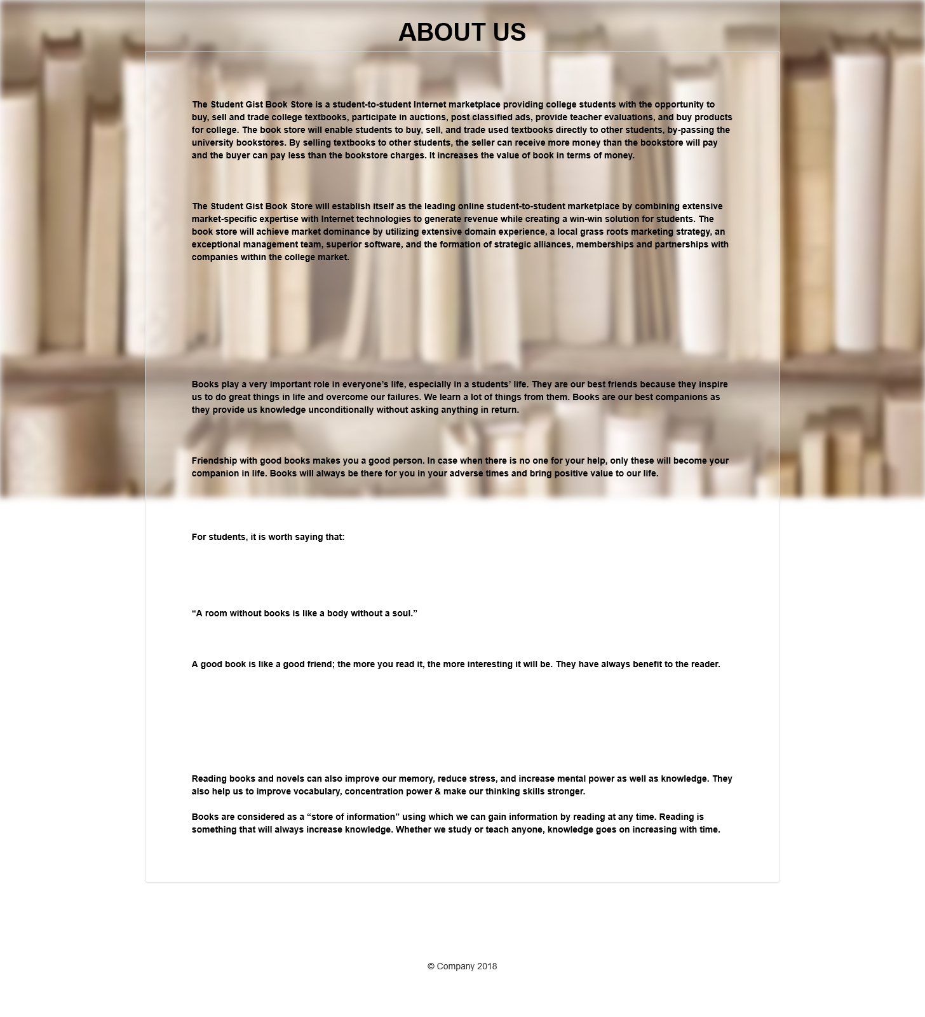
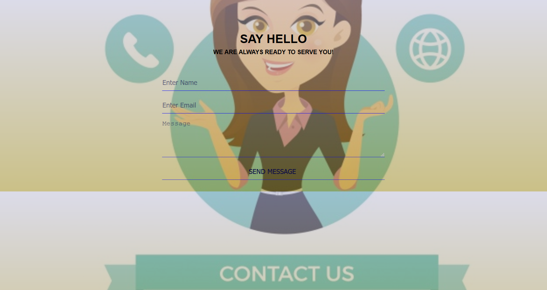
ABOUT-US PAGE:-
CONTACT-US PAGE:-

Slide 15


Future
Students Forum and Independent Groups.
Availability of College/School/Institute related and student oriented papers. Like- Notes, Sample Question Papers, Keynotes, etc…
Dedicated Groups and Clubs.
Live Streaming of Games, Workshops, and Events.
Take/Buy goods on Rent.

Slide 16


